Slide 1
Các controls liên kết dữ liệu
ThS. Trần Anh Dũng

Slide 2
Nội dung
Data Binding
GridView Control
DataList Control
DetailsView Control
FormView Control
DataView class
Data Source Controls in ASP.NET
SqlDataSource Controls in ASP.NET

Slide 3
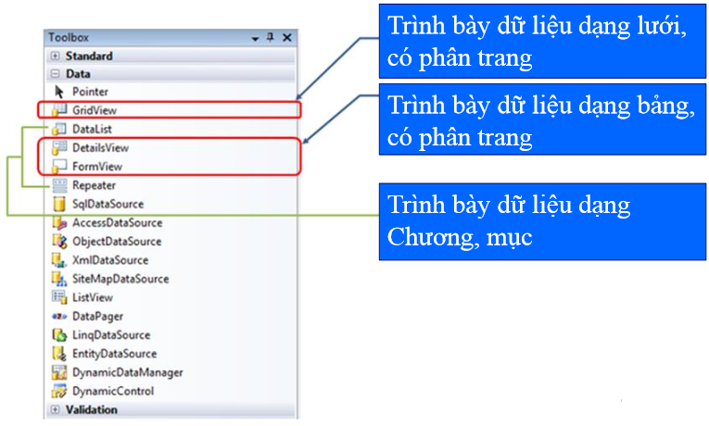
Giới thiệu

Slide 4
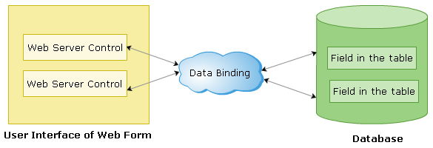
Data Binding
Data Binding is a process by which the data in the controls belonging to the user interface (UI) have a direct link to the data in the database.
Notes:
Kết gán dữ liệu (Data Binding) cho phép tạo ra mối liên hệ giữa một control (ví dụ một listbox hoặc một GridView) với dữ liệu nguồn

Slide 5
Data Binding
The controls that support data binding are called data-bound controls
The advantages of ASP.NET data binding is that it makes data handling more powerful, flexible and extensible.
ASP.NET providers a number of controls that work hand in hand with data binding to enable faster and efficient retrieval and manipulation of data.

Slide 6
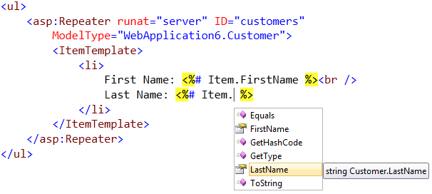
Data Binding
ASP.NET data binding typically involves declarative or inline binding expressions that in the form of <%#....%>
Methods named Eval() and Bind() are used to bind the expressions with the controls.

Slide 7
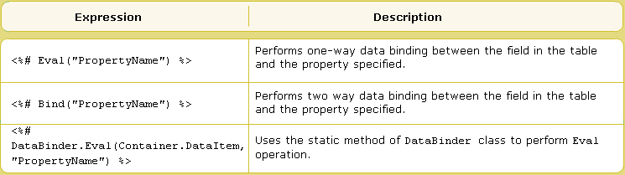
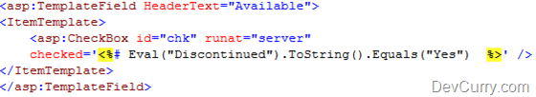
Data Binding

Slide 8
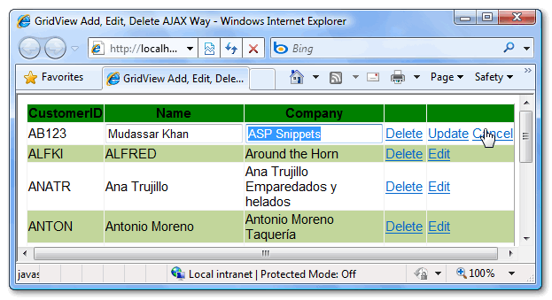
GridView Control
GridView control is a server-side control to display data in tabular format.
GridView control can also be used to edit, delete, update or add new records to a data source (database, XML file,…)

Slide 9
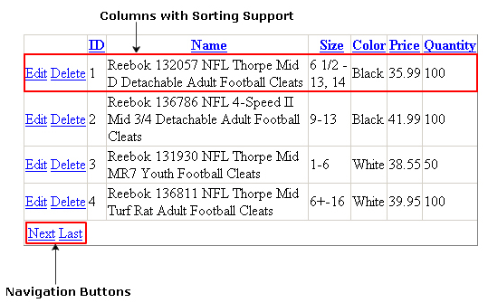
GridView Control
GridView also supports operations like pagging and sorting.

Slide 10
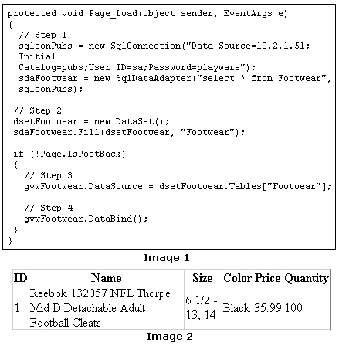
GridView Control

Slide 11


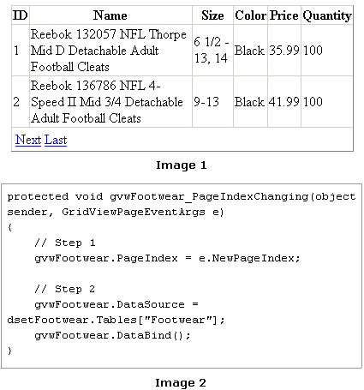
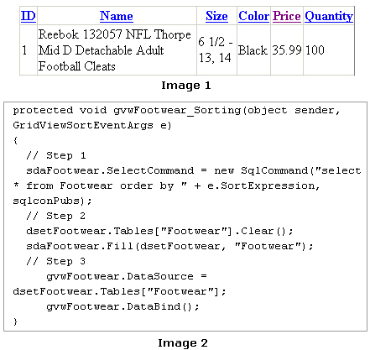
GridView Control

Slide 12


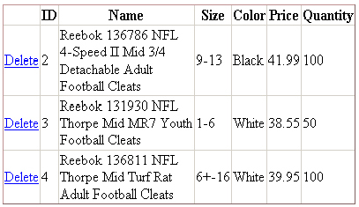
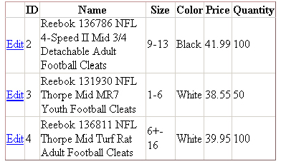

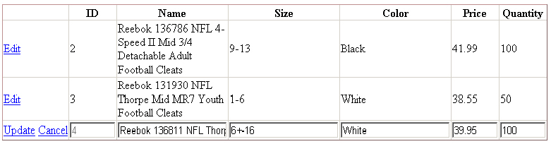
GridView Control

Slide 13
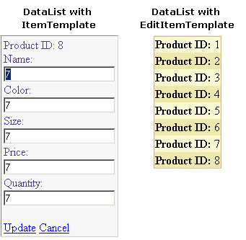
DataList Control
DataList web server control is used to present data in a list. This data is displayed using templates.
Properties
Event
BackColor
BorderColor
BorderStyle
BorderWidth
CellPadding
CellSpacing
GridLines
SelectedIndexChanged
EditCommand
UpdateCommand
CancelCommand
DeleteCommand

Slide 14
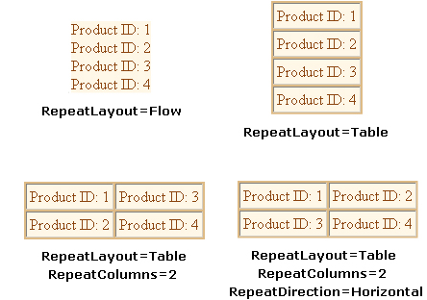
DataList Control

Slide 15
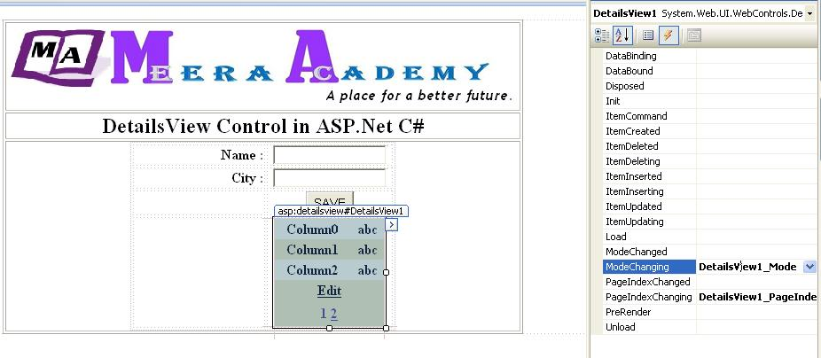
DetailsView Control
The DetailsView control is used to display, edit, insert and delete data in the single row
It is typically used along with the GridView control in a master-detail scenario but can also be used in an independent scenario.

Slide 16
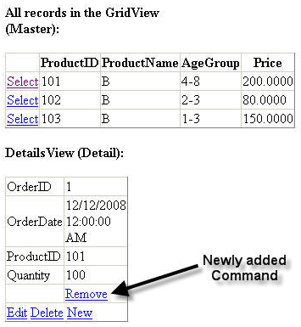
DetailsView Control

Slide 17
DetailsView Control
Properties
Event
Method
AllowPaging
DefaultMode
CurrentMode
AutoGenerateDeleteButton
AutoGenerateInsertButton
AutoGenerateEditButton
ItemInserting
ItemDeleting
ItemUpdating
UpdateItem()
InsertItem()
DeleteItem()

Slide 18
FormView Control
The FormView control is similar to the DetailView control. DetailsView control displays in a tabular format, the FormView control does not have any predefined template to display the records.
Properties
Event
Method
AllowPaging
DefaultMode
CurrentMode
ItemCommand()
ModeChanging()
ItemInserting
ItemDeleting
ItemUpdating
UpdateItem()
InsertItem()
DeleteItem()

Slide 19
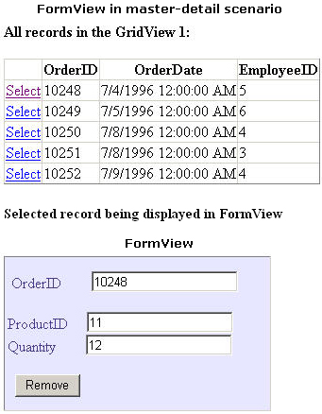
FormView Control

Slide 20
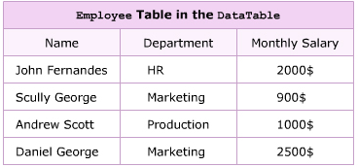
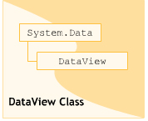
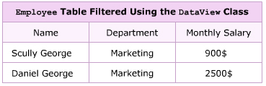
DataView class
Used to sort, filter, search, modify and navigate through the record.
Constructor of this class is a DataTable.

Slide 21
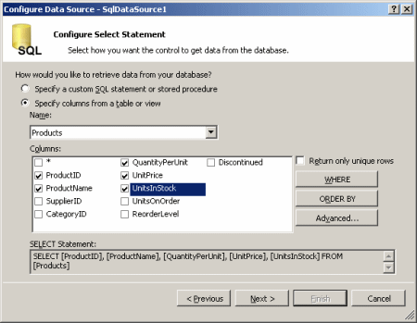
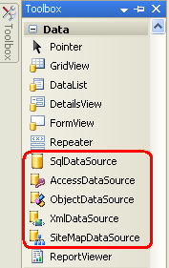
Data Source Controls in ASP.NET
The most commomly used data source controls provided by ASP.NET.
SqlDataSource
XmlDataSource
SiteMapDataSource

Slide 22
Data Source Controls in ASP.NET
The SqlDataSource control is a tabular control, in that it display data in tabular fashion.
The XMLDataSource control enables you to work with data from XML files.
The SiteMapDataSource data source control enables you to work with ASP.NET site navigation through XML-base site maps

Slide 23
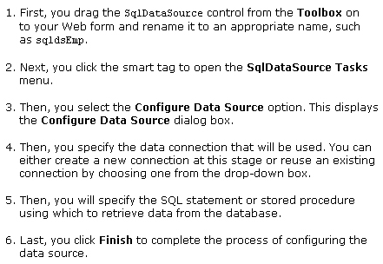
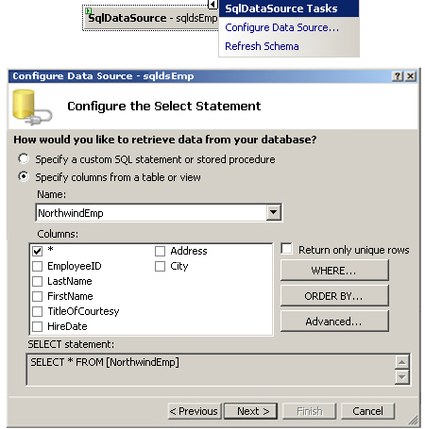
SqlDataSource Controls in ASP.NET

Slide 24
Q & A

